Slide 1
IBM University Engagement Project Submission
“Exploring the Power of Agentic AI with IBM Granite and IBM Bob”

Slide 2

Project Title – AI Legal Aid Multi-Agent System
Domain of Project – Law & Justice (Legal Technology)
Student Name | Recent Passport Photo | Email ID | Mobile number [WhatsApp]
Sailaja Kaisarla |  | sailajakaisarla@gmail.com | 9542327292

Slide 3
Problem Statement -
Problem Statement : AI Legal Aid Multi-Agent System
The Challenge
Legal services are expensive, complex, and difficult to access.
Users struggle to understand legal documents, contracts, and compliance without real-time guidance.
The Objective Build an AI-powered Multi-Agent Legal Aid System that simplifies legal assistance through RAG, document analysis, and intelligent AI agents for faster, accurate, and user-friendly legal support.
Features
Multi-Agent Legal Assistance – Specialized AI agents for legal Q&A, contract review, compliance checking, and case research using RAG-based legal knowledge.
Document Intelligence & Analysis – Upload contracts, agreements, notices, and policies to extract key clauses, identify obligations, detect risks, and generate legal insights.
Interactive Legal Dashboard – A user-friendly dashboard to manage consultations, documents, legal reports, notifications, Sign In and Sign Up, case history, and AI-powered recommendations with downloadable reports.

Slide 4
Proposed Solution -
Proposed Solution: AI-Powered Legal Aid Multi-Agent System
An AI-powered legal platform built with IBM watsonx.ai, Granite Models, Watsonx Runtime, and RAG to provide accessible legal assistance through specialized AI agents.
Key Features
Legal Information Retrieval (RAG): Retrieves and summarizes laws, regulations, and case precedents from trusted legal sources.
Specialized AI Agents: Supports legal research, contract review, compliance checking, document analysis, and legal assistance.
Document Intelligence: Analyses legal documents, detects risks, verifies compliance, and generates reports.
Interactive Dashboard: Enables document upload, legal search, AI chat, case tracking, and report management.
IBM watsonx.ai & Granite Models: Provide accurate legal reasoning, summarization, Q&A, and AI governance.
Overall, A secure, scalable AI legal platform offering real-time legal guidance, document analysis, compliance verification, and intelligent legal support.

Slide 5
Technology Used
IBM Bob platform -For designing and orchestrating multi-agent workflows visually
IBM Grainte model - for eg – ibm-granite-3-2-8b – For natural language understanding, reasoning, and personalization
IBM Cloud – It provides the infrastructure to build, deploy, and scale the Nutrition Agent efficiently. IBM Cloud enables a reliable, secure, and scalable environment for deploying the Nutrition Agent.
RAG– RAG to fetch real data first, then generate intelligent answers, making the Nutrition Agent more trustworthy and effective.
IBM Watsonx.ai - For model deployment, embeddings, and AI governance
Vector Database (FAISS/Chroma) – For RAG-based nutritional data retrieval

Slide 6
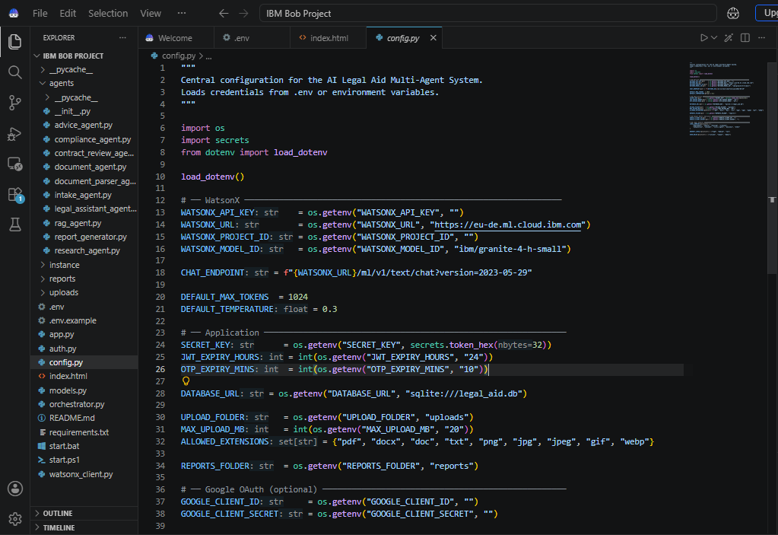
Required Files created using IBM bob -
app.py
requirements.txt
dashboard.js
.env
index.html

Slide 7
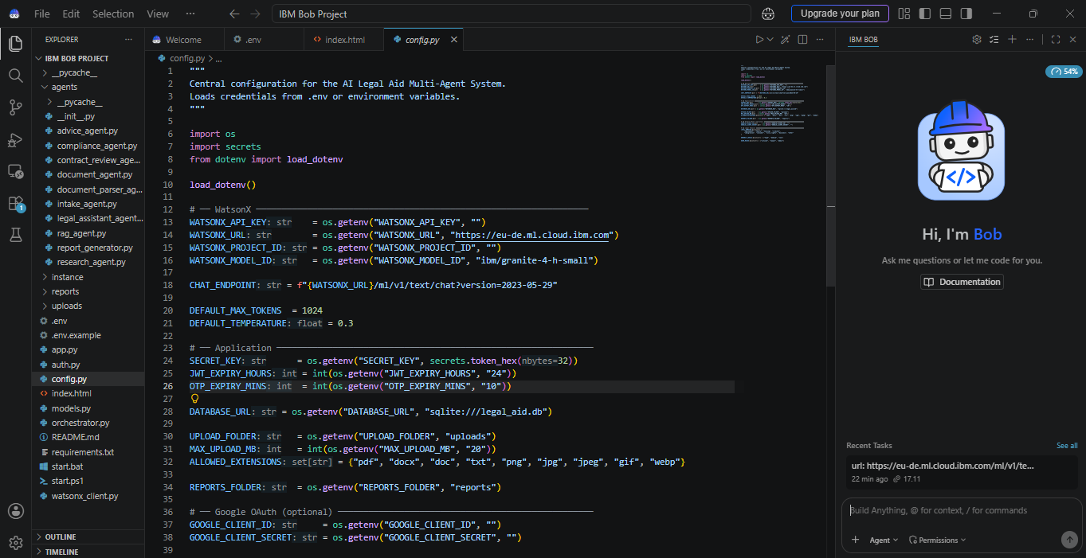
IBM Bob Screenshots:

Slide 8
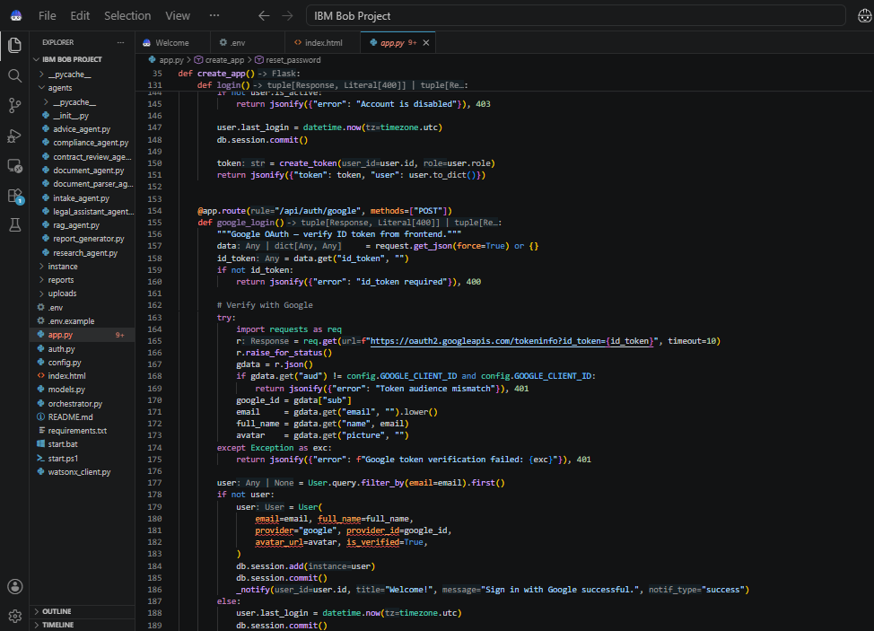

Slide 9
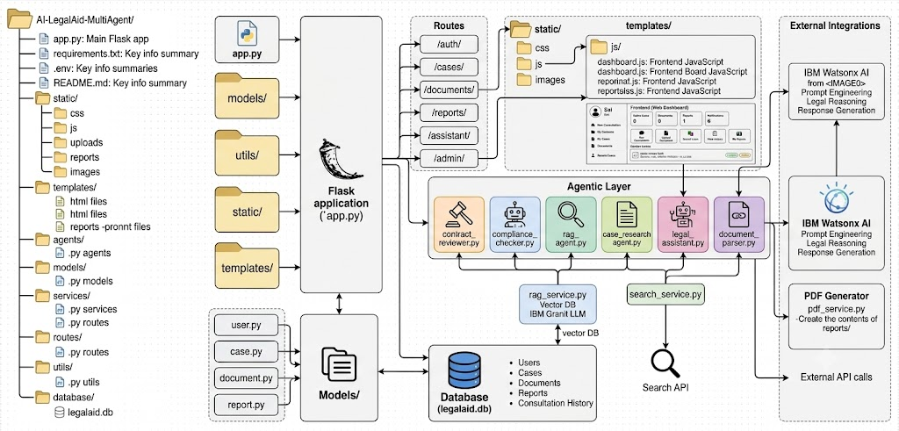
Architecture blueprint for IBM bob:

Slide 10
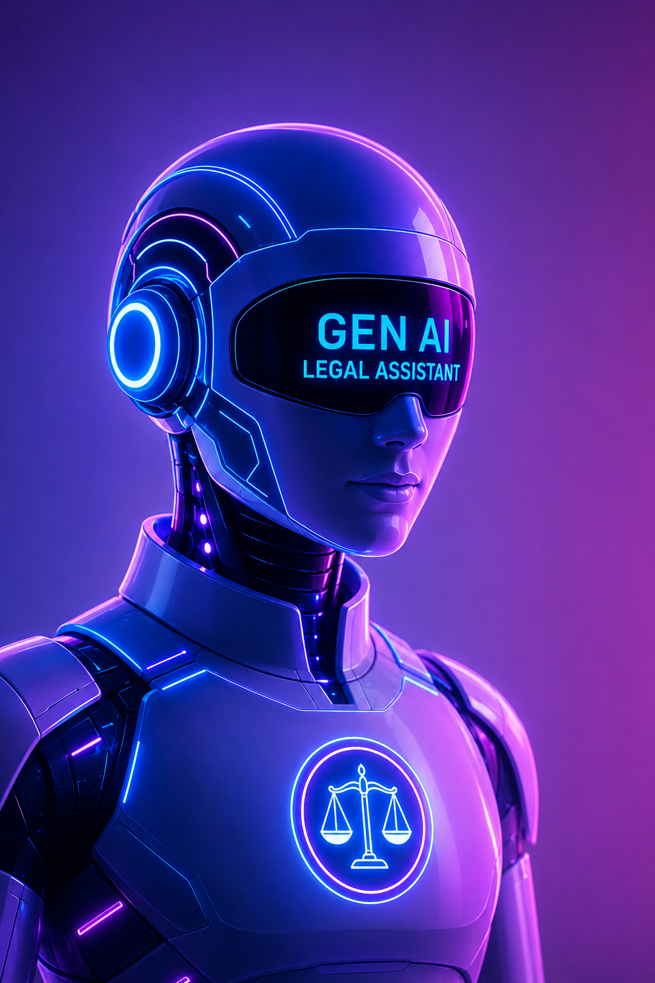
Role of Agentic AI in the AI Legal Aid Multi-Agent System
Legal Research (RAG) – Retrieves and summarizes relevant laws, regulations, and case precedents.
Document Analysis – Identifies key clauses, obligations, risks, and inconsistencies in legal documents.
Conversational Legal Assistant – Provides simple, AI-powered answers to legal queries.
Contract Review – Detects risky or ambiguous clauses and suggests improvements.
Compliance Checking – Verifies documents against legal and regulatory requirements.
Case Research – Finds similar cases and generates legal insights.
Multi-Agent Collaboration – Coordinates specialized AI agents for comprehensive legal assistance.
Report Generation – Creates legal summaries, compliance reports, and recommendations.
Personalized Guidance – Delivers context-aware legal support based on user documents and queries.
24×7 AI Assistance – Provides instant legal guidance with appropriate legal disclaimers.

Slide 11
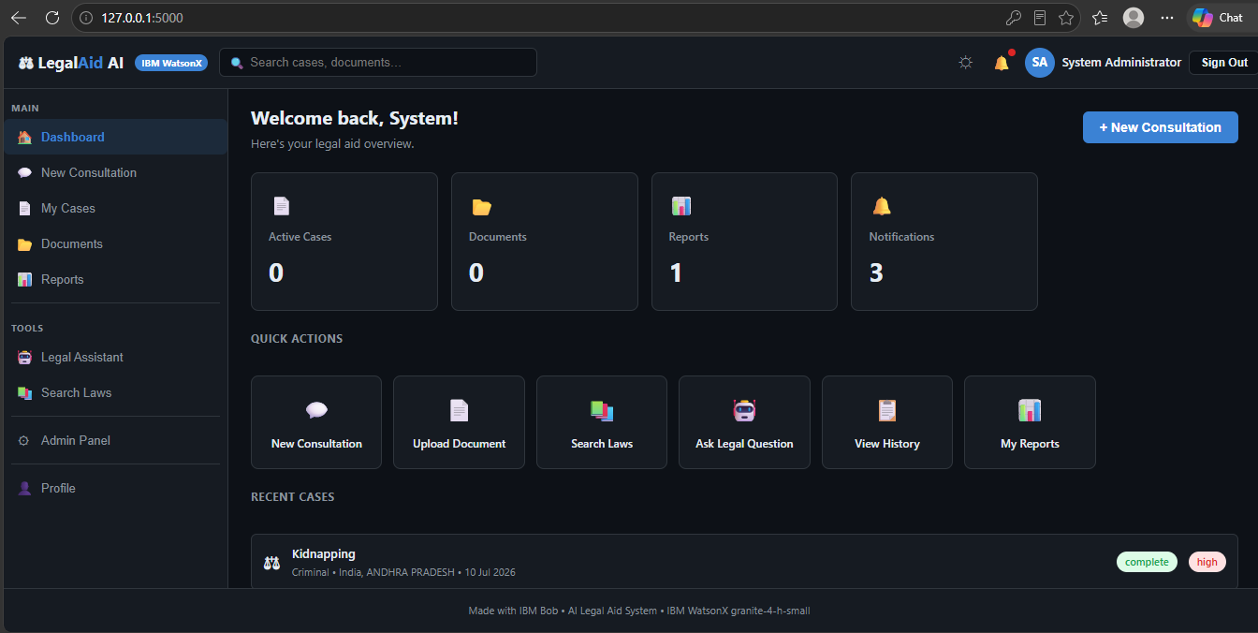
Project Output Screenshot
·
·
·

Slide 12
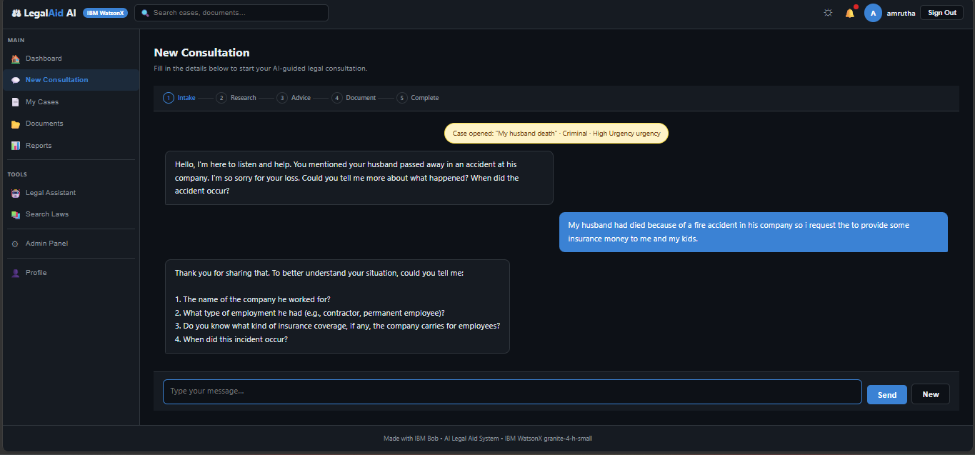
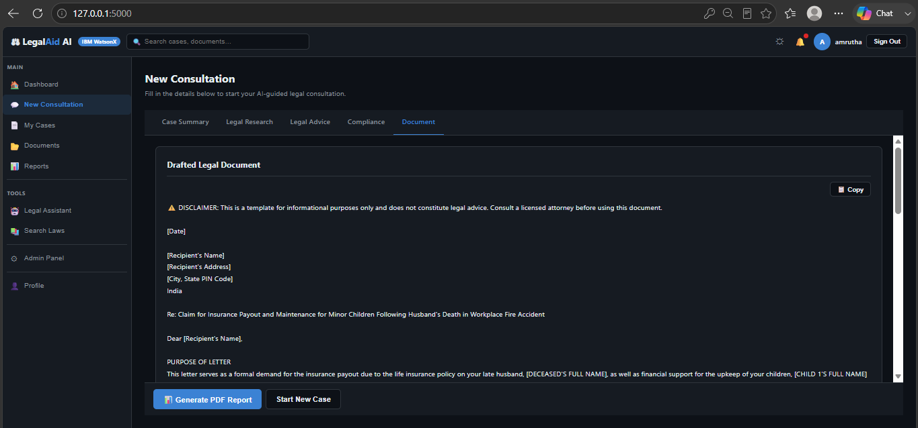
Project Output Screenshot
·
·
·

Slide 13
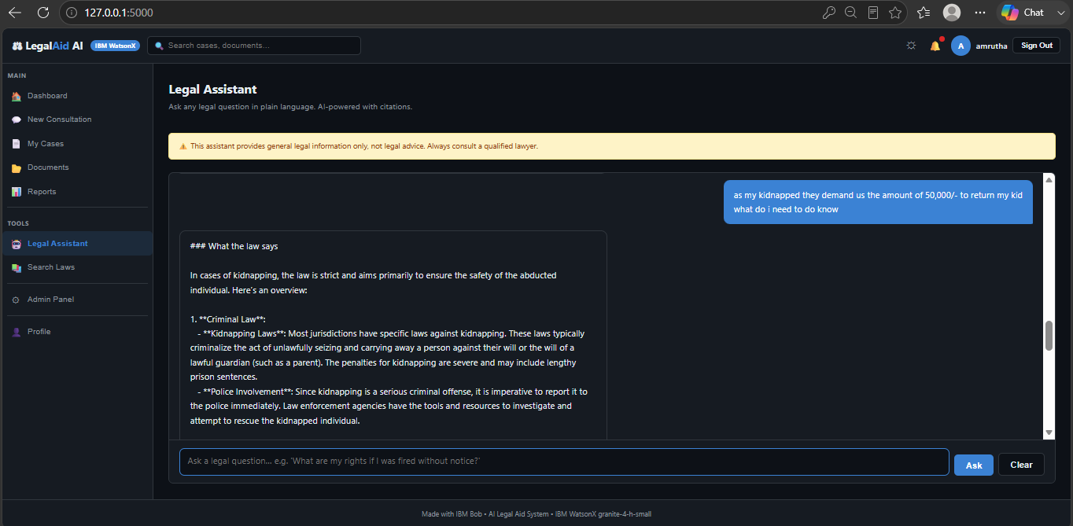
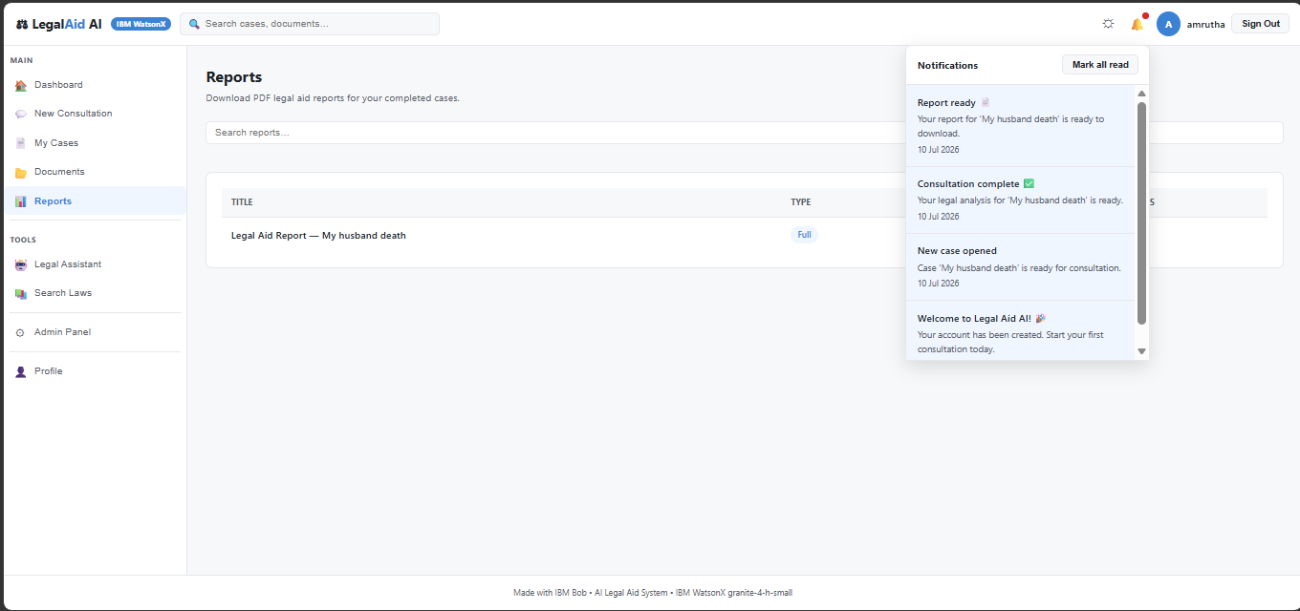
Project Output Screenshot

Slide 14
Novelty and Uniqueness
The proposed AI Legal Aid Multi Agent System stands out by combining Agentic AI, RAG, and personalization into a single intelligent system.
Multi-Agent AI System – Specialized AI agents collaborate to provide comprehensive legal assistance.
RAG-Powered Legal Intelligence – Combines Generative AI with RAG to deliver accurate, context-aware legal information from trusted sources.
All-in-One Legal Platform – Integrates legal consultation, document analysis, compliance checking, case research, AI chat, and report generation.
Smart Document Analysis – Identifies key clauses, legal risks, obligations, and provides actionable recommendations.
User-Friendly Legal Guidance – Simplifies complex legal language into clear, easy-to-understand explanations.
Interactive Decision Dashboard – Offers legal insights, case tracking, compliance status, and downloadable reports.
Scalable Modular Architecture – Easily extendable with new AI agents, legal domains, and regulations.
Powered by IBM Watsonx – Uses IBM Granite models and Agentic AI for secure, explainable, and enterprise-ready legal assistance.

Slide 15
Git Hub Link
Github URL – https://github.com/sailajakaisarla/IBM-Bob-Project Drive Link – https://drive.google.com/file/d/1uDR4s-Mwo9r772fWTff7yXo5VZzG3JVK/view?usp=sharing
·
·

Slide 16
Future Scope
Government Legal Integration – Connect with legal databases for real-time laws, amendments, judgments, and case updates.
Voice & Multilingual Support – Enable voice interaction and support multiple regional languages.
AI Legal Document Drafting – Automatically generate agreements, notices, affidavits, and legal documents.
Lawyer Consultation – Connect users with verified legal professionals for expert guidance.
Predictive Legal Analytics – Predict case outcomes, legal risks, and timelines using AI.
Automated Compliance Monitoring – Track regulatory changes and notify users of compliance risks.
Blockchain Document Verification – Securely verify and protect legal documents from tampering.
Smart Case Tracking – Monitor court case status, hearings, and legal deadlines with notifications.
Explainable AI – Provide AI reasoning, confidence scores, and source citations for transparent legal assistance.
·
·
·

Slide 17
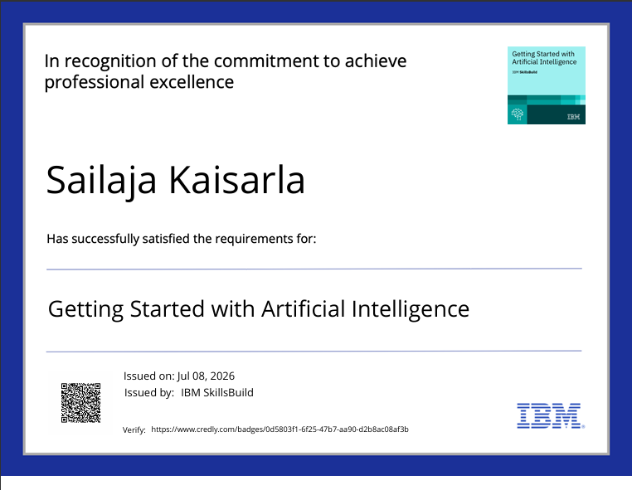
Certificates Earned:

Slide 18
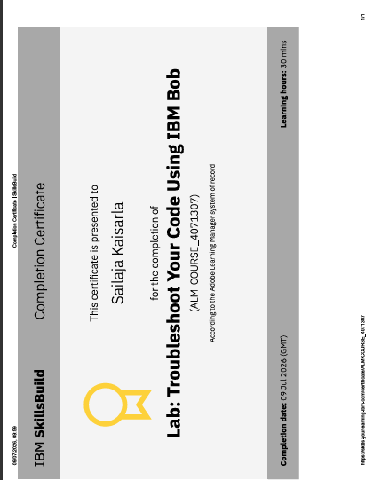
Certificates Earned:​

Slide 19
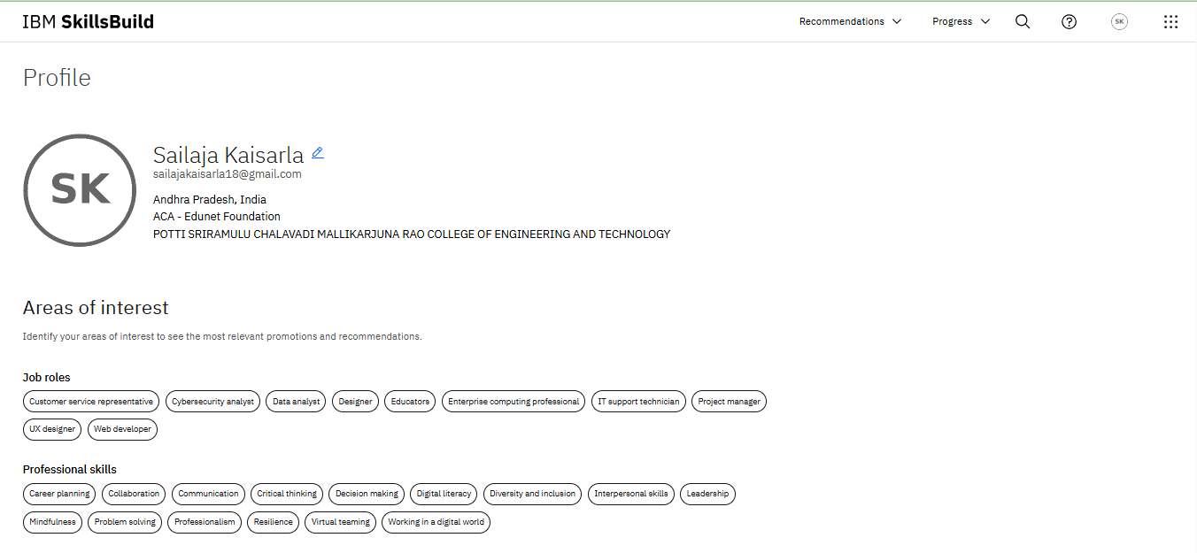
IBM SKILLSBUILD PROFILE

Slide 20


